Slide 1

Significance of Cloud Computing to ensure Road Safety
Presented by---
Name: N. I. Md. Ashafuddula
Student ID: 18204016
Course name: Cloud Computing (CSE-6305)
Department: CSE
Program: MSc in CSE
Presented to---
Name: Professor Dr. Mohammad Abdur Rouf, Department of Computer Science and Engineering, DUET, Gazipur

Slide 2
Outlines
Introduction
Causes of Road Accident
Related Works
Keywords & Terms
Analysis of Researchers proposed
Solutions
Result
Drawbacks
Conclusion
Findings
Conclusion

Slide 3
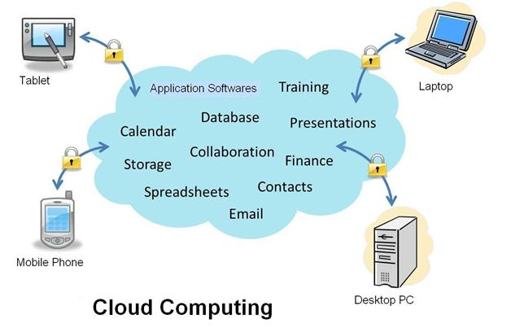
Introduction
Cloud computing is a technology that uses the internet for storing and managing data on remote servers and then access data via the internet.
Example: Amazan AWS, Microsft Azure, Google Cloud Services etc.
Fig: Cloud Computing

Slide 4
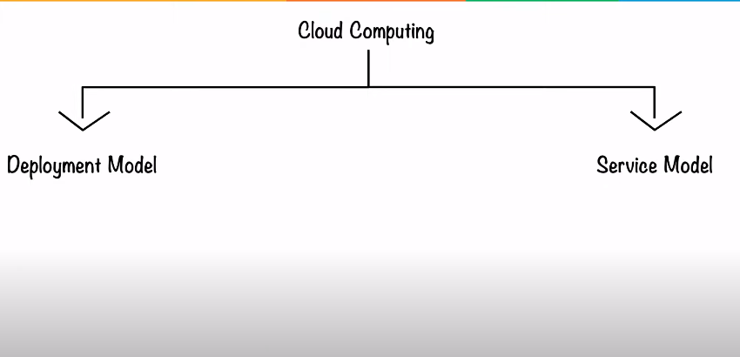
Cloud Computing
Cloud Computing has 2 types of model---
Deployment model
Service model

Slide 5
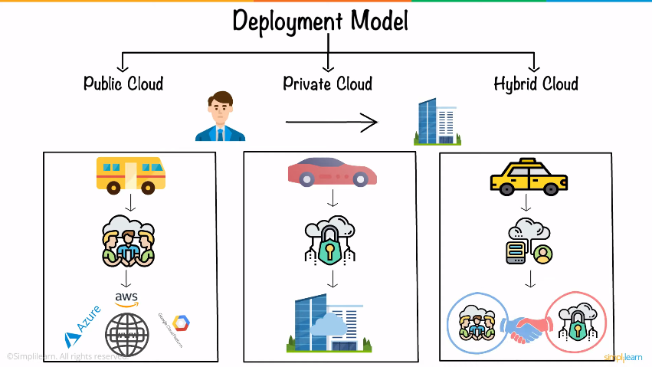
Cloud Computing (Cont’d)
Cloud computing can be categorized into 3 general types[1]---
Public Cloud provides a shared platform that is accessible to the general public through an Internet connection.
Examples: Amazon Elastic Compute Cloud (EC2), Microsoft Azure, IBM's Blue Cloud, Sun Cloud, and Google Cloud.
Fig: Deployment model (Cloud computing)
[1] https://www.bmc.com/blogs/public-private-hybrid-cloud/

Slide 6
Cloud Computing (Cont’d)
Private cloud is cloud computing that is dedicated solely to one’s organization. Private cloud provides computing services to a private internal network (within the organization) and selected users instead of the general public.
Examples: HP Data Centers, Microsoft, Elastra-private cloud, and Ubuntu
Fig: Deployment model (Cloud computing)
[1] https://www.bmc.com/blogs/public-private-hybrid-cloud/

Slide 7
Cloud Computing (Cont’d)
Hybrid cloud is any environment that uses both public and private clouds.
The best hybrid cloud provider companies are Amazon, Microsoft, Google, Cisco, and NetApp.
Fig: Deployment model (Cloud computing)
[1] https://www.bmc.com/blogs/public-private-hybrid-cloud/

Slide 8
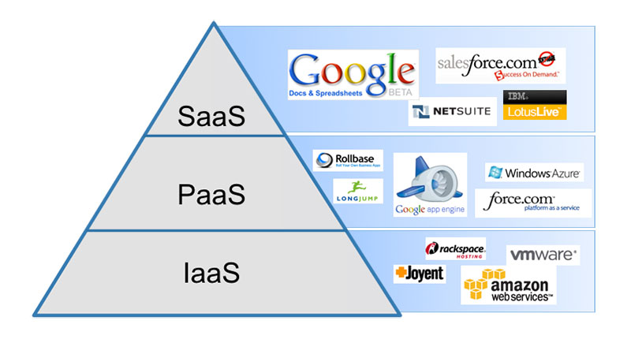
Cloud Computing (Cont’d)
There are 3 main types of Cloud computing service model such as SaaS, PaaS, IaaS.
IaaS: IaaS is the on-demand availability of almost infinitely scalable computing resources as services over the internet. It eliminates the need for enterprises to procure, configure, or manage infrastructure themselves, and they only pay for what they use. cloud-based services, pay-as-you-go for services such as storage, networking, and virtualization.
PaaS: hardware and software tools available over the internet i.e. AWS Elastic Beanstalk, Heroku, OpenShift, Apache Stratos, Magento Commerce Cloud.
SaaS: software that’s available via a third-party over the internet i.e. Google Apps, Salesforce, Dropbox,
Fig: Cloud computing services

Slide 9
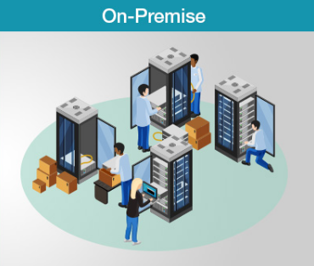
Cloud Computing (Cont’d)
On-premise: software that’s installed in the same building as your business.
1. Installation --- Time-consuming
2. Availability --- When bought and deployed
3. Investment --- High
4. Business Risks --- High
Fig: On-Premise model

Slide 10
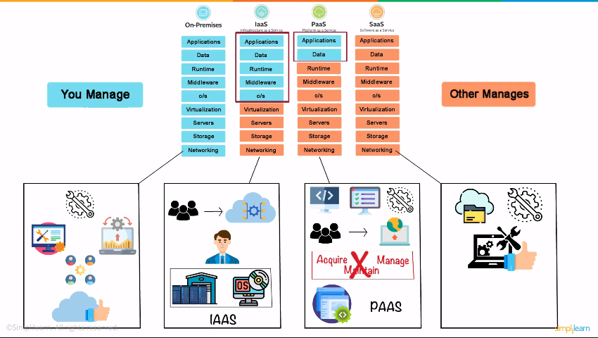
Cloud Computing (Cont’d)

Slide 11
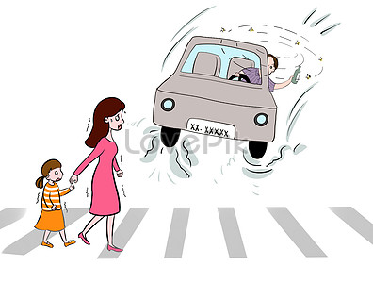
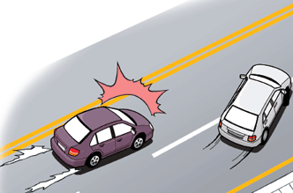
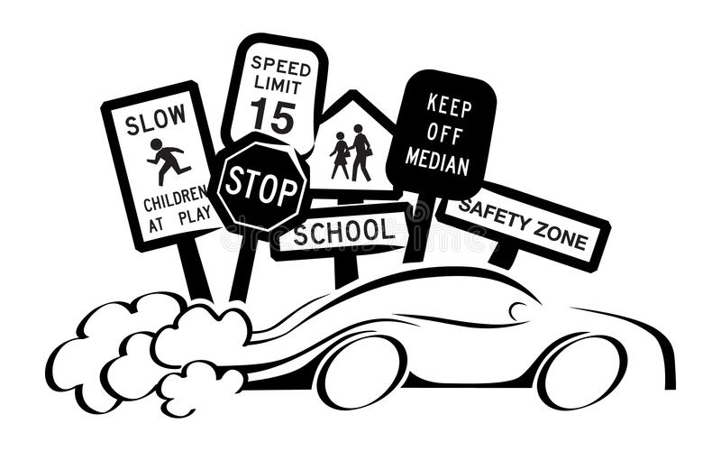
Causes of Road Accident
Violations of Traffic Rules
Reckless driving
Over speeding
Fig: Reckless driving
Fig: Violation of traffic rule
Fig: Over speeding

Slide 12
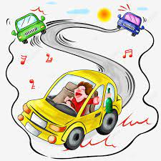
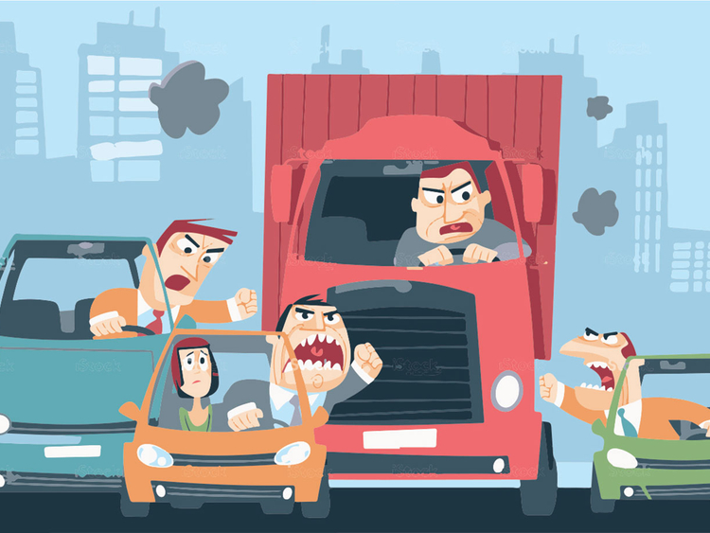
Causes of Road Accident (Cont’d)
4. Illegal & Dangerous competition
5. Hazardous Road
6. Lacking of vehicle fitness
Fig: Hazardous road
Fig: Illegal & Dangerous competition

Slide 13
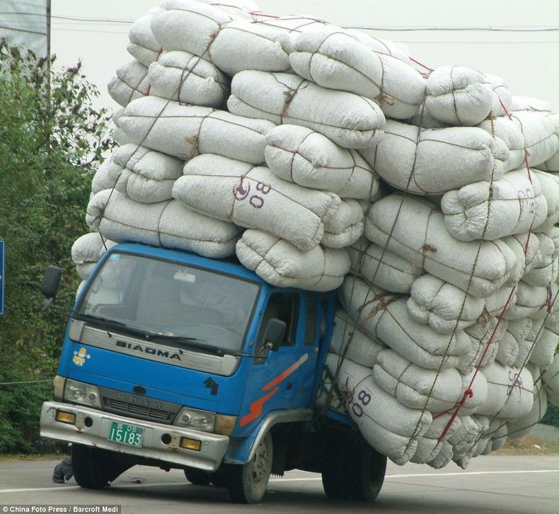
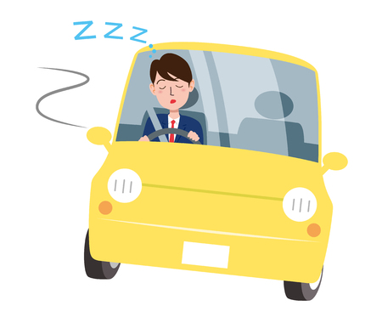
Causes of Road Accident (Cont’d)
7. Overloading
8. Overtaking
9. Driving Long time without any break
10. Frequent change of lanes
11. Bad weather condition
Etc.
Fig: Overloading
Fig: Driving Long time

Slide 14
Related Works
Intelligent Accident Management System using IoT and Cloud Computing (2016)
IoT based real time traffic control using cloud computing (2018)
AVRA BANGLADESH Collection, Analysis & Visualization of Road Accident Data in Bangladesh (2013)
Mobile Cloud System for Road Safety (2018)
PREVENTING Road Accident using Cloud Computing (2020)

Slide 15
Keywords & Terms
Cloud Computing
Internet of Things (IoT)
Sensors
Wireless Sensor Network
Road Safety
Web Services
GPS
GSM
Accident Monitoring and Detection
Image processing
Object recognition

Slide 16
Intelligent Accident Management System using IoT and Cloud Computing (2016) [1]
Introductions:
implemented the concept of IoT, with crash sensors.
sensors will help the vehicles which have collided or are in need of any help. In case of accident, there will be some collision in the vehicle which will be sensed by the sensors.
The crash sensors will measure and report the intensity of collision based on certain parameters and operations related to the automotive design of the vehicle.
Motivation:
Presently, the vehicles are coming with a built in accident tracking system but they are not very popular among the public. Major disadvantages of such systems comprises of factors like non-portability, high cost, limited options, false delivery etc.

Slide 17
Intelligent Accident Management System using IoT and Cloud Computing (2016) [1] (Cont’d)
Proposed Methodology:
If accident occurs?
Yes
Generate a intensity value [Z, scale(1-4)]
If (Z<=2)
Inform the nearby sensors about the event
else
No
Cloud server is searched for appropriate people and the requests are generated to other helping agents like ambulance, car agency, hospital etc.
The higher level help is required. The cloud server is informed about the collision.
Do nothing

Slide 18
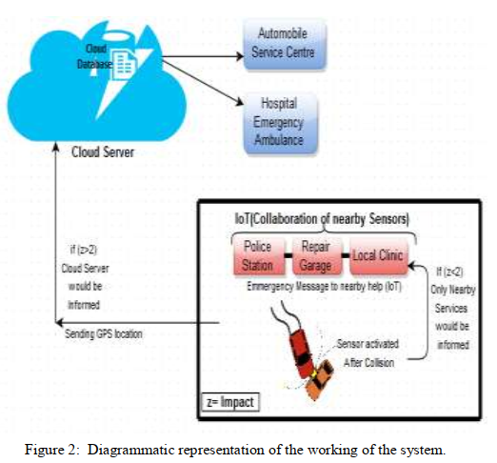
Intelligent Accident Management System using IoT and Cloud Computing (2016) [1] (Cont’d)
Proposed Methodology:
The model presented here involves a collective integration of different types of sensors as well as microcontroller units which acknowledge emergency calling system. This technology includes the benefits of GSM modem used as automatic emergency calling system and GPS sensor for location calling. GSM modem requires a SIM card and works with a GSM wireless network. Accelerometer sensors and vibration sensors are collaborated.

Slide 19
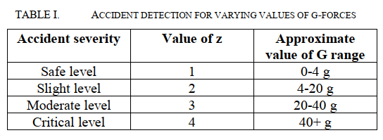
Intelligent Accident Management System using IoT and Cloud Computing (2016) [1] (Cont’d)
Result analysis:
The estimate of g-forces measured by the accelerometer sensors can be used as a reference to be rated on a scale in order to provide an idea about the depth of the accident.
Conclusion:
With the help of IoT, Cloud and the Wireless Sensor Network. Given the idea that could be taken into study using just the GSM modem and required sensors to globally inter-connect with the IoT and the cloud because with the use of cloud computing, the higher impact i.e. the emergency situation could be monitored by the cloud server, saving the precious lives.

Slide 20
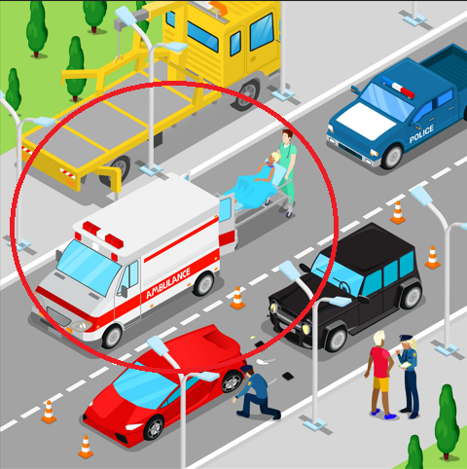
IoT based real time traffic control using cloud computing (2018) [2]
Introduction:
Increasing number of vehicles in the road has given rise to the traffic jam. This effects the operation of ambulance. To avoid the traffic jam for the ambulance, a new idea is proposed here with image processing, CCTV camera monitoring, sound detection & Cloud-Computing.
Motivation:
Due to this there exists a lot of traffic on road which will affect the daily life of an individual. Lot of time and effort is wasted by spending time on road. The patients struck in the traffic will have to suffer a lot and this may threat their life too.
Fig: Ambulance waiting in Traffic Jam

Slide 21
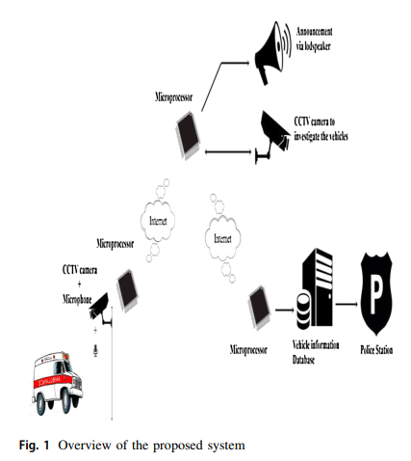
IoT based real time traffic control using cloud computing (2018) [2] (Cont’d)
Proposed Methodology:
1. CCTV and an microphone, which continuously monitors the traffic and sends the information to the processor for further processing.
2. The image processing algorithms are implemented to detect the presence of the ambulance and audio processing is done to detect the siren. Once when the vehicle is detected, necessary signal is transmitted to the next station through internet to indicate the arrival of the ambulance.
3. The announcement of the ambulance arrival is notified by the speaker and all the vehicles are insisted to make way for the ambulance.

Slide 22
IoT based real time traffic control using cloud computing (2018) [2] (Cont’d)
Proposed Methodology:
4. A camera is installed to keep track of a vehicle which does not follow the announcement and image is captured and number plate is extracted and owner information is passed on the nearest police station through internet to take further actions.
5. Minimum of one parameter is sufficient to identify the vehicle, that is the image of the vehicle. By this we can differentiate between the ambulance and other vehicles.
Implementation:
Open source Matlab code is modified to use for image processing & audio processing to detect Ambulances & number plates and other vehicles.
The data transfer between the two stations is demonstrated by using two computers which communicate through internet using TCP/IP.
Cloud computing is used to store and control the information data and for further processing.

Slide 23
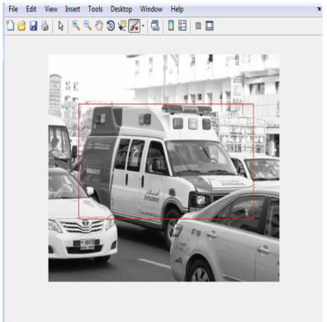
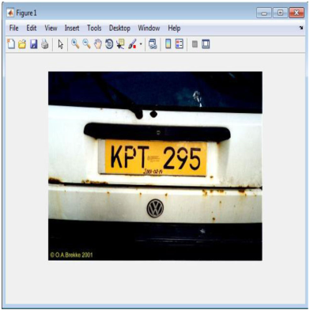
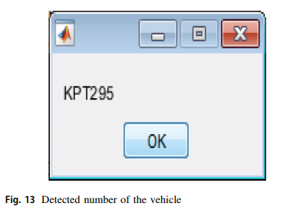
IoT based real time traffic control using cloud computing (2018) [2] (Cont’d)
Detection:
Fig: Detect vehicle number
Fig: Ambulance detection
Fig: Capture number plate

Slide 24
IoT based real time traffic control using cloud computing (2018) [2] (Cont’d)
Conclusion:
In this paper they showed a model to provide a path for ambulance in a emergency situation and identify the vehicles that violates the announcement thus, it is possible to control the traffic system automatically and efficiently.
Future scope include implementing the verified scripts on to the digital signal processors and deploy in the real traffic environment.

Slide 25

Findings
1. Sensors along with Cloud-Computing can be used to detect and response to an vehicle collision. [1]
Thus, we can solve the situation
Reckless driving
Over speeding
Illegal & dangerous competition
Overloading
Frequent change of lane
Bad weather condition
Collision detection and response accordingly

Slide 26
Findings
2. CCTV camera monitoring system, image processing, audio processing with Cloud-Computing can be used to solve [2]---
Violation of Traffic Rules
Illegal & dangerous competition
Overtaking recklessly
Long time driving without break

Slide 27
Conclusion
Thus, we can conclude that to ensure Road Safety we need to deploy a system that uses Cloud Computing along with various sensors, image processing, audio processing & image acquisition technique.
Here, Cloud Computing can be used to enable and connect the devices to respond in real-time for the required action and image & the audio processing part also can be done in a cloud model easily where the cloud computing model could provide us---
Unlimited storage for images & audios to store
Deep learning & Machine learning tools, API’s for the processing purpose
Database to keep tracking the devices information and actions if anything happens

Slide 28
Thank you

